Slide 1
FCA – Difficult Conversations
Responding to Information Requirements – s165 FSMA
16 March 2021
Elisabeth Bremner - Partner, CMS Law
Alison McHaffie - Partner, CMS Law

Slide 2
Your speakers
Elisabeth Bremner
Alison McHaffie
Partner, CMS
Elisabeth.bremner@cms-cmno.com
Partner, CMS
alison.mchaffie@cms-cmno.com

Slide 3
When can a s165 Information Requirement be issued?
ch
Who
When
What
Why
An authorised person
Former authorised persons
Certain connected persons
Or if FCA has power to require person to produce, but document in possession of 3rd person – can ask 3rd person
When reasonably required in connection with regulatory functions
Specific information
Specific documents
Within a reasonable period
At a specified place
In a specified form – could be verbal in meeting
Can require an explanation of the document
Officer may require production without delay
Supervisory functions
Enforcement functions

Slide 4
What does it mean?
General information gathering power – doesn’t mean under formal investigation
No need for link between any regulatory concerns and the firm itself – purpose may relate to other parties or broader statutory functions
May recognise data requested subject to third party confidentiality/privacy obligations
Or perhaps firm not authorised (no Principle 11), or regulator concerned won’t cooperate, or potential data integrity/retention issues

Slide 5
Who can you discuss it with? (1)
Notice will usually include confidentiality warning
Doesn’t prohibit from consulting with internal and external counsel
But limit knowledge and circulation internally:
Guard against risk of prejudicing/impeding FCA investigation
Prevent circulation of damaging rumours
Mitigate risk of destruction of evidence
Avoid risk of ‘unauthorised disclosure’:
Occasionally notice may include information provided to the regulator by another party – this information is likely to be protected under s348 FSMA - criminal offence to make an unauthorised disclosure

Slide 6
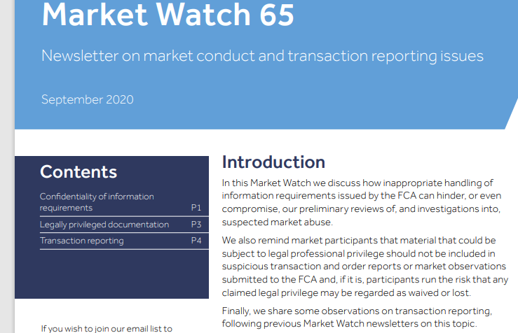
Who can you discuss it with? (2)
Authorised firms need to be careful in cases of market abuse – check who can discuss with
If believe need to engage other parts of organisation, discuss with FCA first to avoid prejudicing inquiries or investigations
Once have consent to contact staff in another department for help in responding, ensure that those staff are carefully selected, and told:
they are not to contact other staff without informing Compliance, who should then seek FCA approval
the information is required to fulfil an FCA information requirement
what may happen if the confidentiality of the information requirement is not maintained
Inappropriate handling of information requirements can hinder, or even compromise, preliminary reviews / investigations into suspected market abuse.
Clearly state should be kept strictly confidential, and should not be discussed with staff outside Compliance without FCA prior agreement
“You should be aware that if you do not follow the confidentiality requirements of FCA requests you run the risk of regulatory scrutiny or action, and the reputational damage that this may cause. You should also be aware that if you inadvertently facilitate tipping off to the fact of our investigation you may also hinder our shared objective of enhancing market integrity”.

Slide 7
What should you check? (1)
Check FCA has jurisdiction
Who is it for?
Does FCA have the power in respect of persons listed in the notice?
Do those persons have possession of/access to the data/information required?
Otherwise, may not be protected re any 3rd party confidentiality/data privacy obligations as not been compelled to produce
Where is the data held? No extra-territorial effect
If in doubt, seek expert advice
Check scope
Wide power/relatively low threshold – includes requirement to provide information not recorded anywhere
No protection against self-incrimination
Be clear on what you need to provide
Engage in early discussion with FCA to determine exactly what they are seeking and how you can best assist
May be possible to narrow down and establish purpose

Slide 8
What should you check? (2)
Check timeframes
Can you meet the timeframes?
If not, speak up early on and agree on a timetable for delivery
May be able to agree a staged approach
Consider
Cooperation obligations:
Principle 11
COCON Rule 3
Even if served entity does not have possession/access but another regulated entity in the group does, may wish to still produce (absent any third party confidentiality obligations etc) but be clear doing so voluntarily

Slide 9
Protected items and banking confidentiality
Protected items/ LPP
FCA cannot require production of ‘protected items’
Any material that could be subject to LPP (on behalf of the firm or another party) shouldn’t be provided unless prepared to give limited waiver of privilege
Check for any direct extracts or quotes from any LPP material - avoid risk of loss of LPP
Limited waivers - FCA can’t accept any condition which would restrict its ability to use the information in exercise of its statutory functions (so could be used if enforcement action taken)
If unsure whether a document is subject to LPP, seek independent legal advice
.
Banking confidentiality
Protection from disclosure where owe banker duty of confidence
But protection limited and doesn’t apply where:
Person who owes the duty of confidence is under investigation or a member of that person’s group
Person to whom the duty of confidence is owed is the person under investigation or a member of that person’s group
The person to whom the duty of disclosure is owed consents; or
The requirement to provide such information is specifically authorised by the FCA.

Slide 10
Practicalities
Single point of contact to liaise with FCA
Detailed records of all searches
Copies of all information/documents provided
Good notes of all meetings/calls with FCA
Review what provide – check in scope
Identify and isolate LPP materials
Check any banking confidentiality data required.
Be cognisant of GDPR obligations
If searches required are expansive – explain challenges to FCA
If unable to locate data – be satisfied have taken adequate steps and keep clear record of steps taken
Don’t leave too late to seek more time if needed
When providing materials, clearly record the basis on which this has been done – be careful not to mislead
Ensure colleagues aware of confidentiality obligations and importance of cooperation
Limit internal communications to the facts – avoid expressing any judgements or opinions that could later become disclosable
Maintain open and constructive dialogue with FCA re steps taken and delivery

Slide 11
Special situations – short notice requirements
Sometimes FCA will issue short notice requirements: arriving first thing in the morning with a notice seeking delivery of information that same day
Ask for initial discussion to determine purpose of the request – be helpful
Ask for some time to discuss separately away from FCA
Consider external legal advice
Determine what can practically provide within the timeframe – try to agree on a way forward
Agree data retention measures
Shadow FCA
FCA may bring internal forensics team – don’t be pressured into handing over more than scope
LPP
Suggest FCA asks an independent lawyer to attend to determine any disputes over privilege
Or agree to keep documents over which privilege is claimed separate from other materials to determine at a later date

Slide 12
Consequences of failing to comply
Contempt of court (firm and officers)
Criminal offence – false/misleading/ destruction
Principle 11 / COCON Rule 3 breach
Warrant to seize

Slide 13
Afterwards
Check FCA has everything needs – offer assistance
If so – follow up with own enquiries/ investigation
Remember self-reporting
Review data – any cause for concern?

Slide 14
Next time
FCA – Difficult Conversations
Self-notification – when things go wrong
30 March 2021
Elisabeth Bremner - Partner, CMS Law
Alison McHaffie - Partner, CMS Law
FCA – Difficult Conversations

Slide 15
Your free online legal information service.
A subscription service for legal articles
on a variety of topics delivered by email.
^{cms-lawnow.com}
Your expert legal publications online.
In-depth international legal research
and insights that can be personalised.
^{eguides.cmslegal.com}
CMS Legal Services EEIG (CMS EEIG) is a European Economic Interest Grouping that coordinates an
organisation of independent law firms. CMS EEIG provides no client services. Such services are solely
provided by CMS EEIG’s member firms in their respective jurisdictions. CMS EEIG and each of its
member firms are separate and legally distinct entities, and no such entity has any authority to bind any other. CMS EEIG and each member firm are liable only for their own acts or omissions and not those of each other. The brand name “CMS” and the term “firm” are used to refer to some or all of the member firms or their offices.
^{CMS locations:}
Aberdeen, Algiers, Amsterdam, Antwerp, Barcelona, Beijing, Belgrade, Berlin, Bogotá, Bratislava, Bristol, Brussels, Bucharest, Budapest, Casablanca, Cologne, Dubai, Duesseldorf, Edinburgh, Frankfurt, Funchal, Geneva, Glasgow, Hamburg, Hong Kong, Istanbul, Kyiv, Leipzig, Lima, Lisbon, Ljubljana, London, Luanda, Luxembourg, Lyon, Madrid, Manchester, Mexico City, Milan, Monaco, Moscow, Munich, Muscat, Paris, Podgorica, Poznan, Prague, Reading, Rio de Janeiro, Riyadh, Rome, Santiago de Chile, Sarajevo, Seville, Shanghai, Sheffield, Singapore, Skopje, Sofia, Strasbourg, Stuttgart, Tirana, Utrecht, Vienna, Warsaw, Zagreb and Zurich.
^{cms.law}

